Slide 1
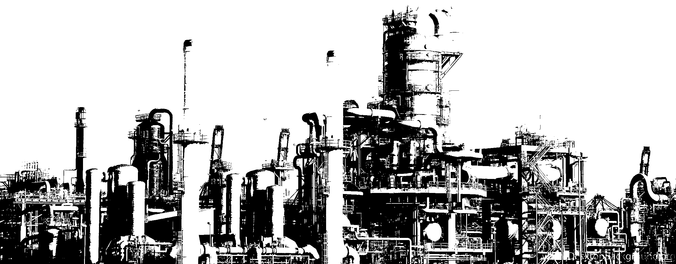

PLCs & Ladder Logic
Introduction and examples

Slide 2
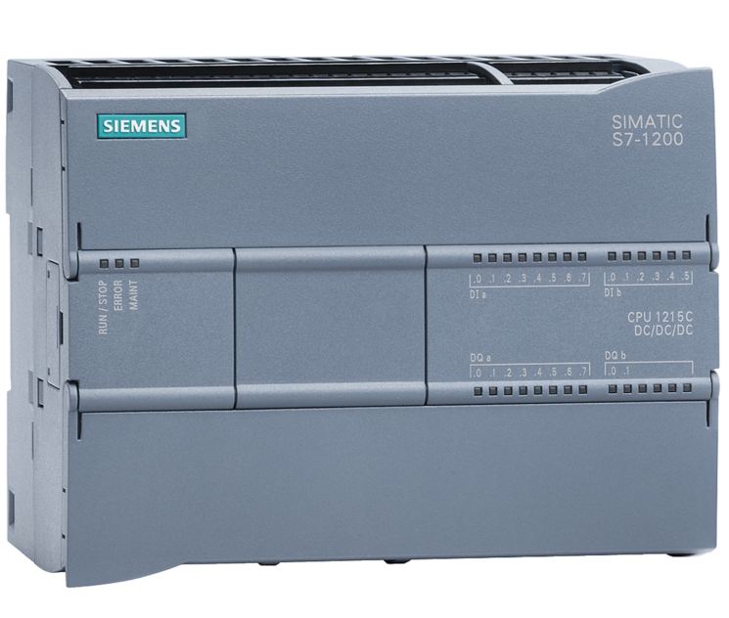
Programmable Logic Controller (PLC)
Industrial digital computer
Image source:
https://assets.new.siemens.com/siemens/assets/api/uuid:4914a9f5-b3fd-4f6e-a529-71982b690203/width:1125/quality:high/version:1556178605/s7-1200-cpu1215c.png

Slide 3


Programmable Logic Controller (PLC)
Industrial digital computer
Provides control solutions for industrial environments
Image source:
https://www.arivaca-connection.com/wp-content/uploads/2019/07/images1996-5d3ecdaea9860-1024x683.jpg

Slide 4

Programmable Logic Controller (PLC)
Industrial digital computer
Provides control solutions for industrial environments
Designed to be operated by engineers with limited knowledge of computers and programming languages
Image source:
https://www.wikihow.com/images/thumb/b/b9/Become-a-Software-Engineer-Step-5-Version-2.jpg/aid48188-v4-728px-Become-a-Software-Engineer-Step-5-Version-2.jpg.webp

Slide 5
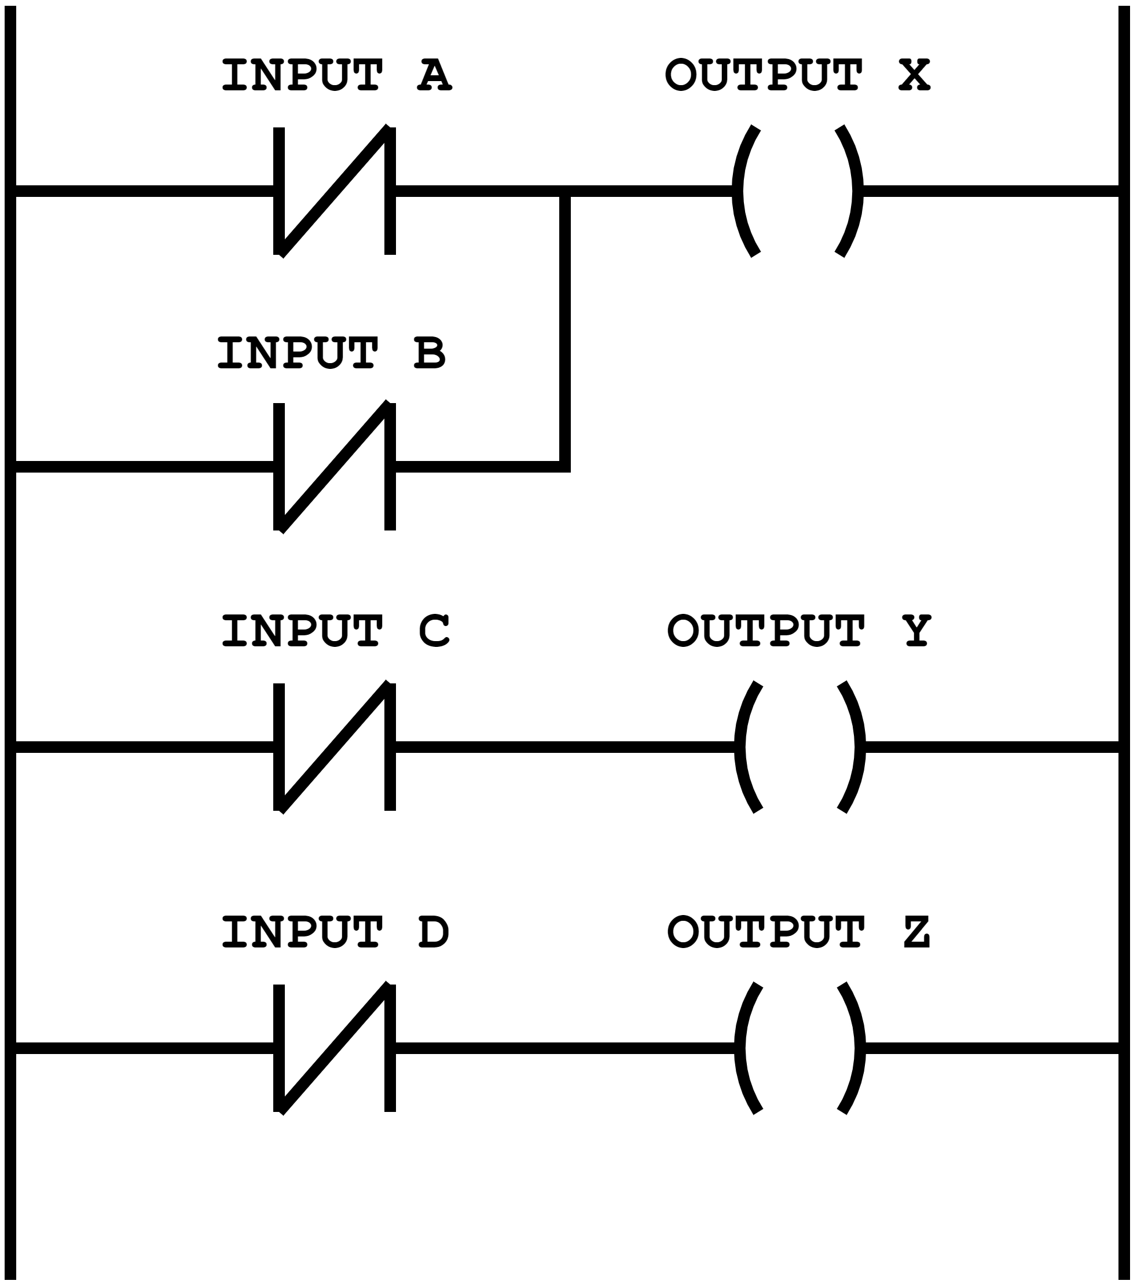
Ladder Logic
Graphical language used to write machine code for PLCs

Slide 6
Ladder Logic
Graphical language used to write machine code for PLCs
Every software is built using diagrams

Slide 7
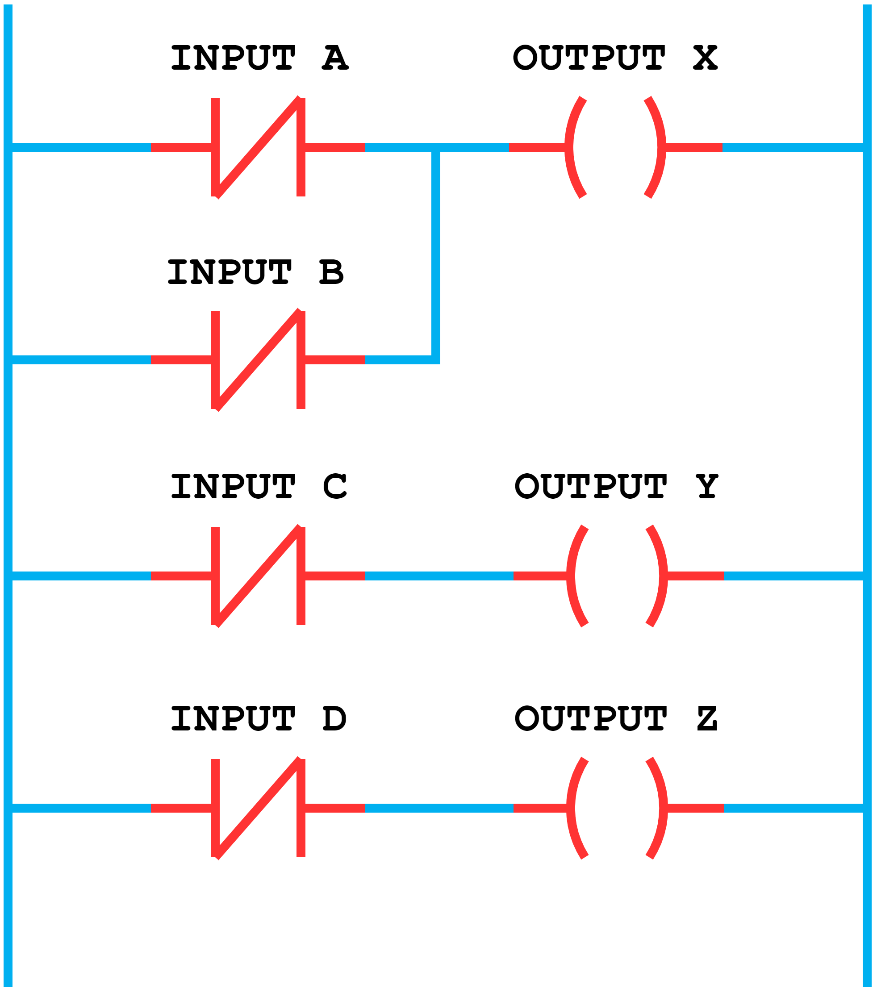
Ladder Logic
Graphical language used to write machine code for PLCs
Every software is built using diagrams
Every diagram is made up of symbols, representing input and output elements, and lines, which connect and organize these symbols logically into the diagrams

Slide 8
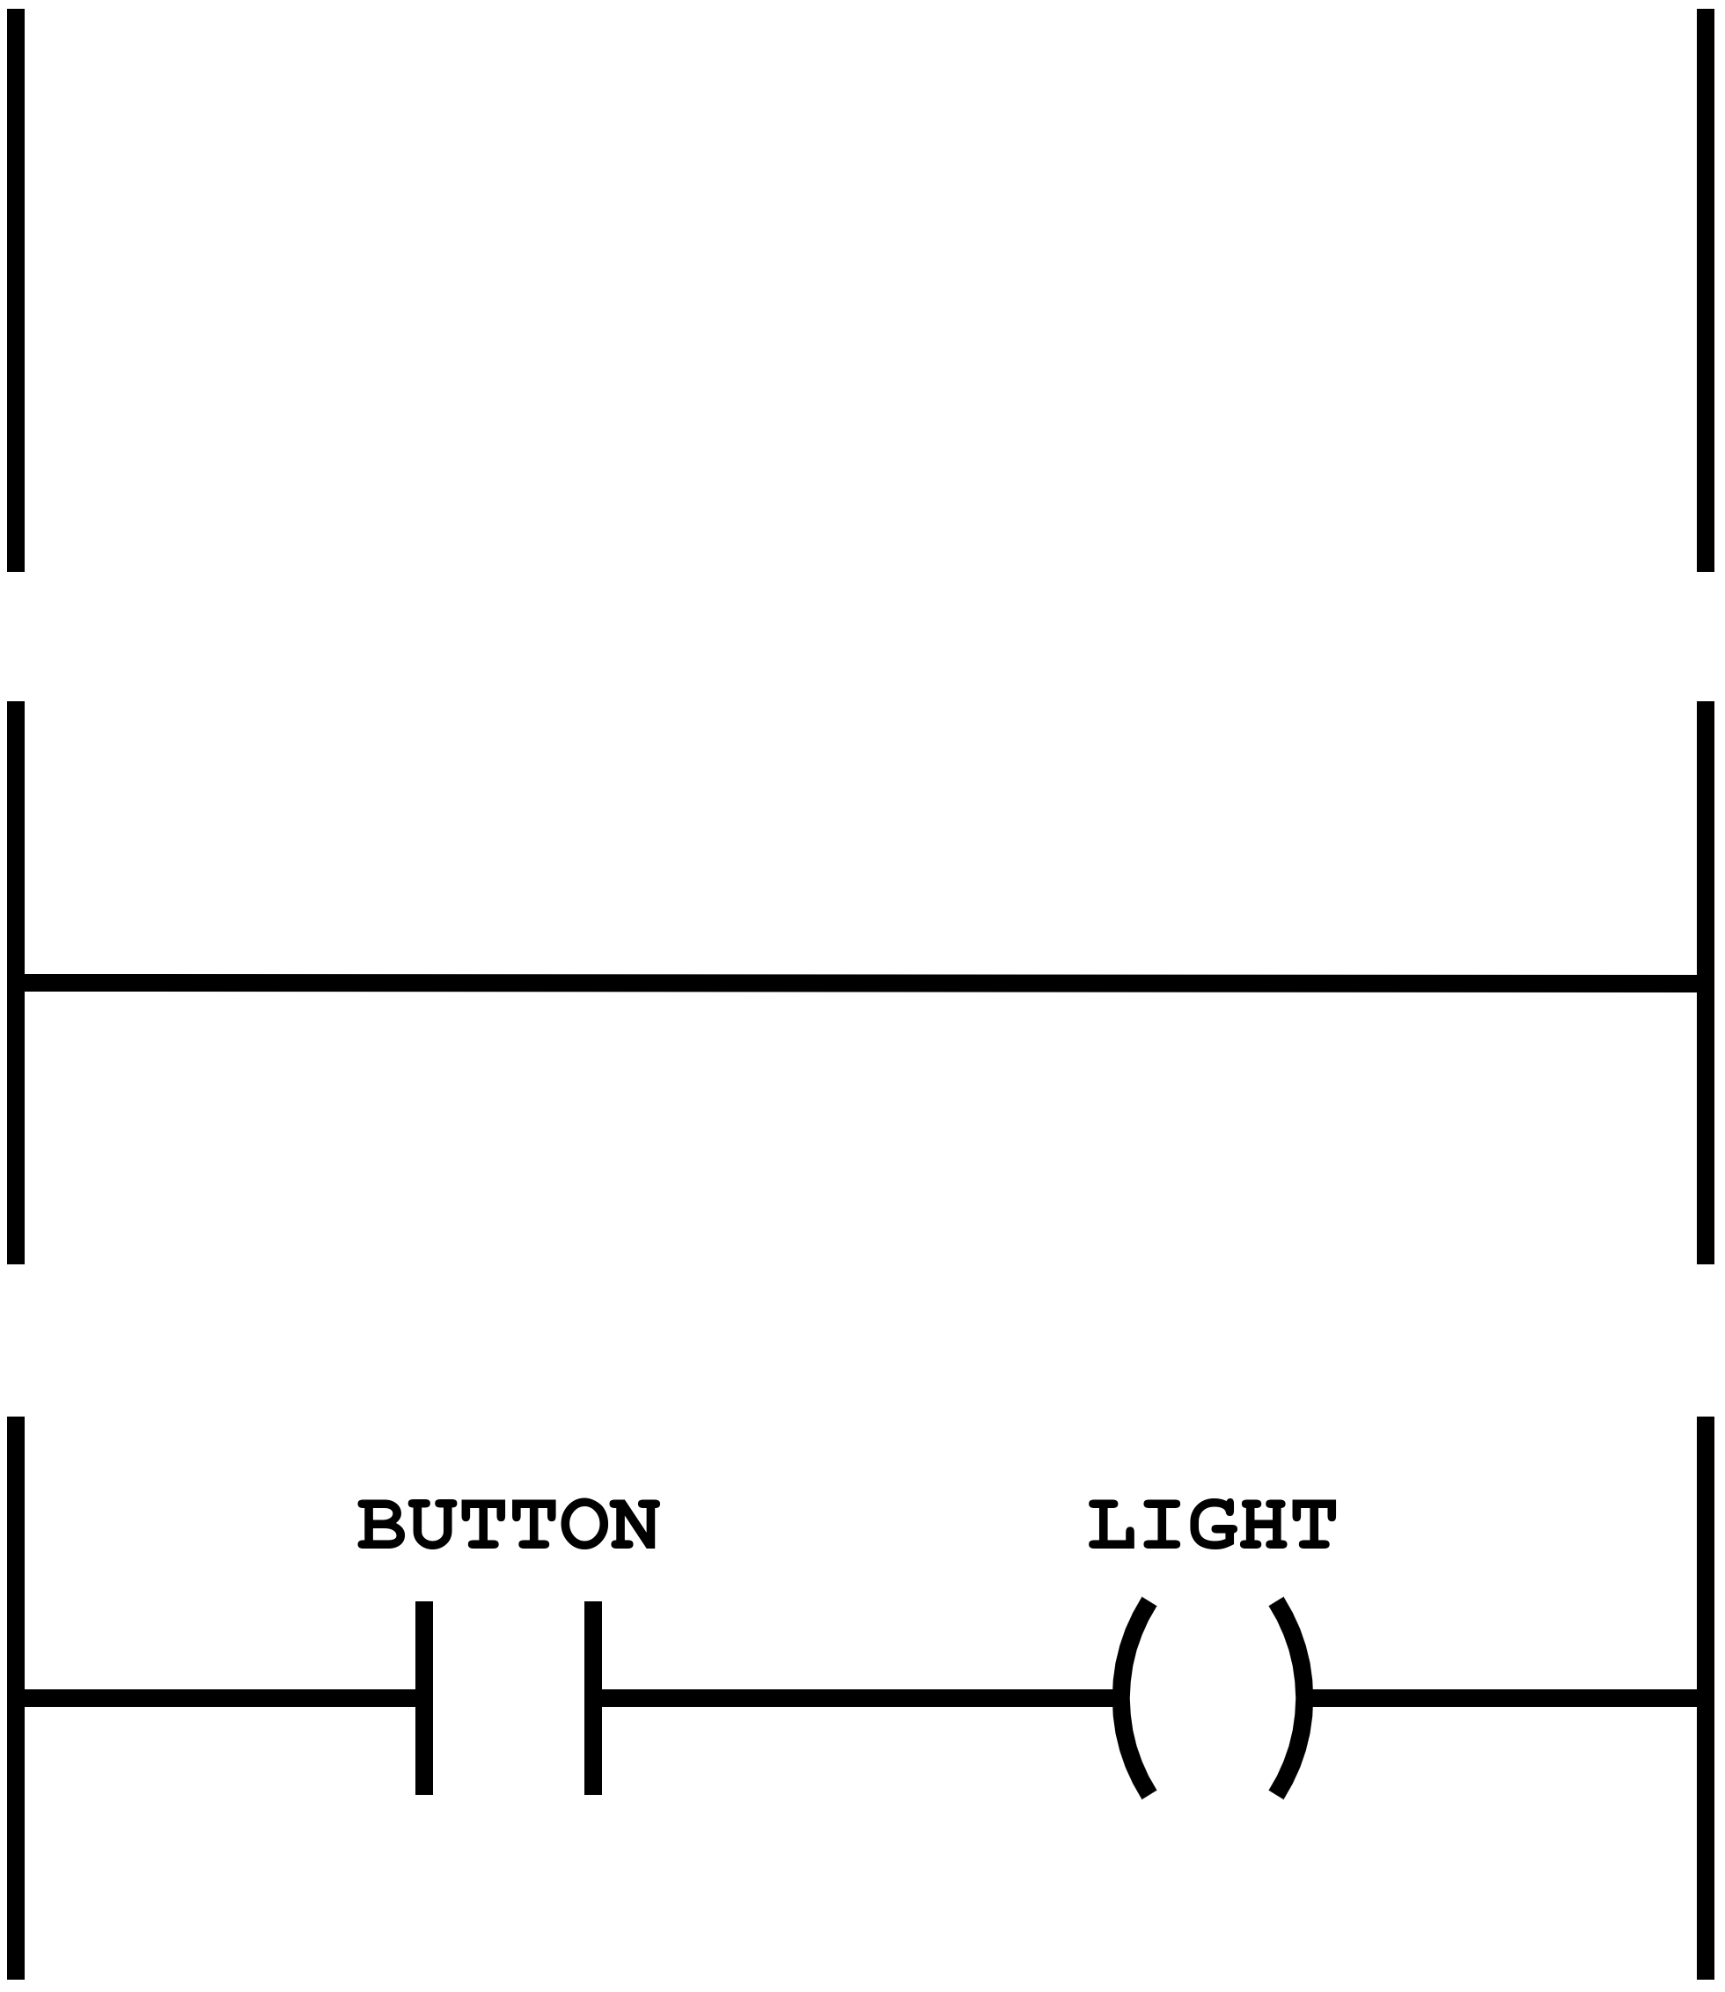
Building a diagram
A diagram starts with two vertical lines called power rails, between which circuits are connected

Slide 9
Building a diagram
A diagram starts with two vertical lines called power rails, between which circuits are connected
One or more horizontal lines (rungs) are added connecting the two power rails

Slide 10
Building a diagram
A diagram starts with two vertical lines called power rails, between which circuits are connected
One or more horizontal lines (rungs) are added connecting the two power rails
Input and output symbols are placed on the rungs and identified by descriptive labels

Slide 11
Building a diagram
A diagram starts with two vertical lines called power rails, between which circuits are connected
One or more horizontal lines (rungs) are added connecting the two power rails
Input and output symbols are placed on the rungs and identified by descriptive labels
Every rung starts with one or more input symbols and ends with one output symbol

Slide 12









Examples of inputs
Examples of outputs
Switches
Motors
Pumps
Sensors
Valves
Lights

Slide 13
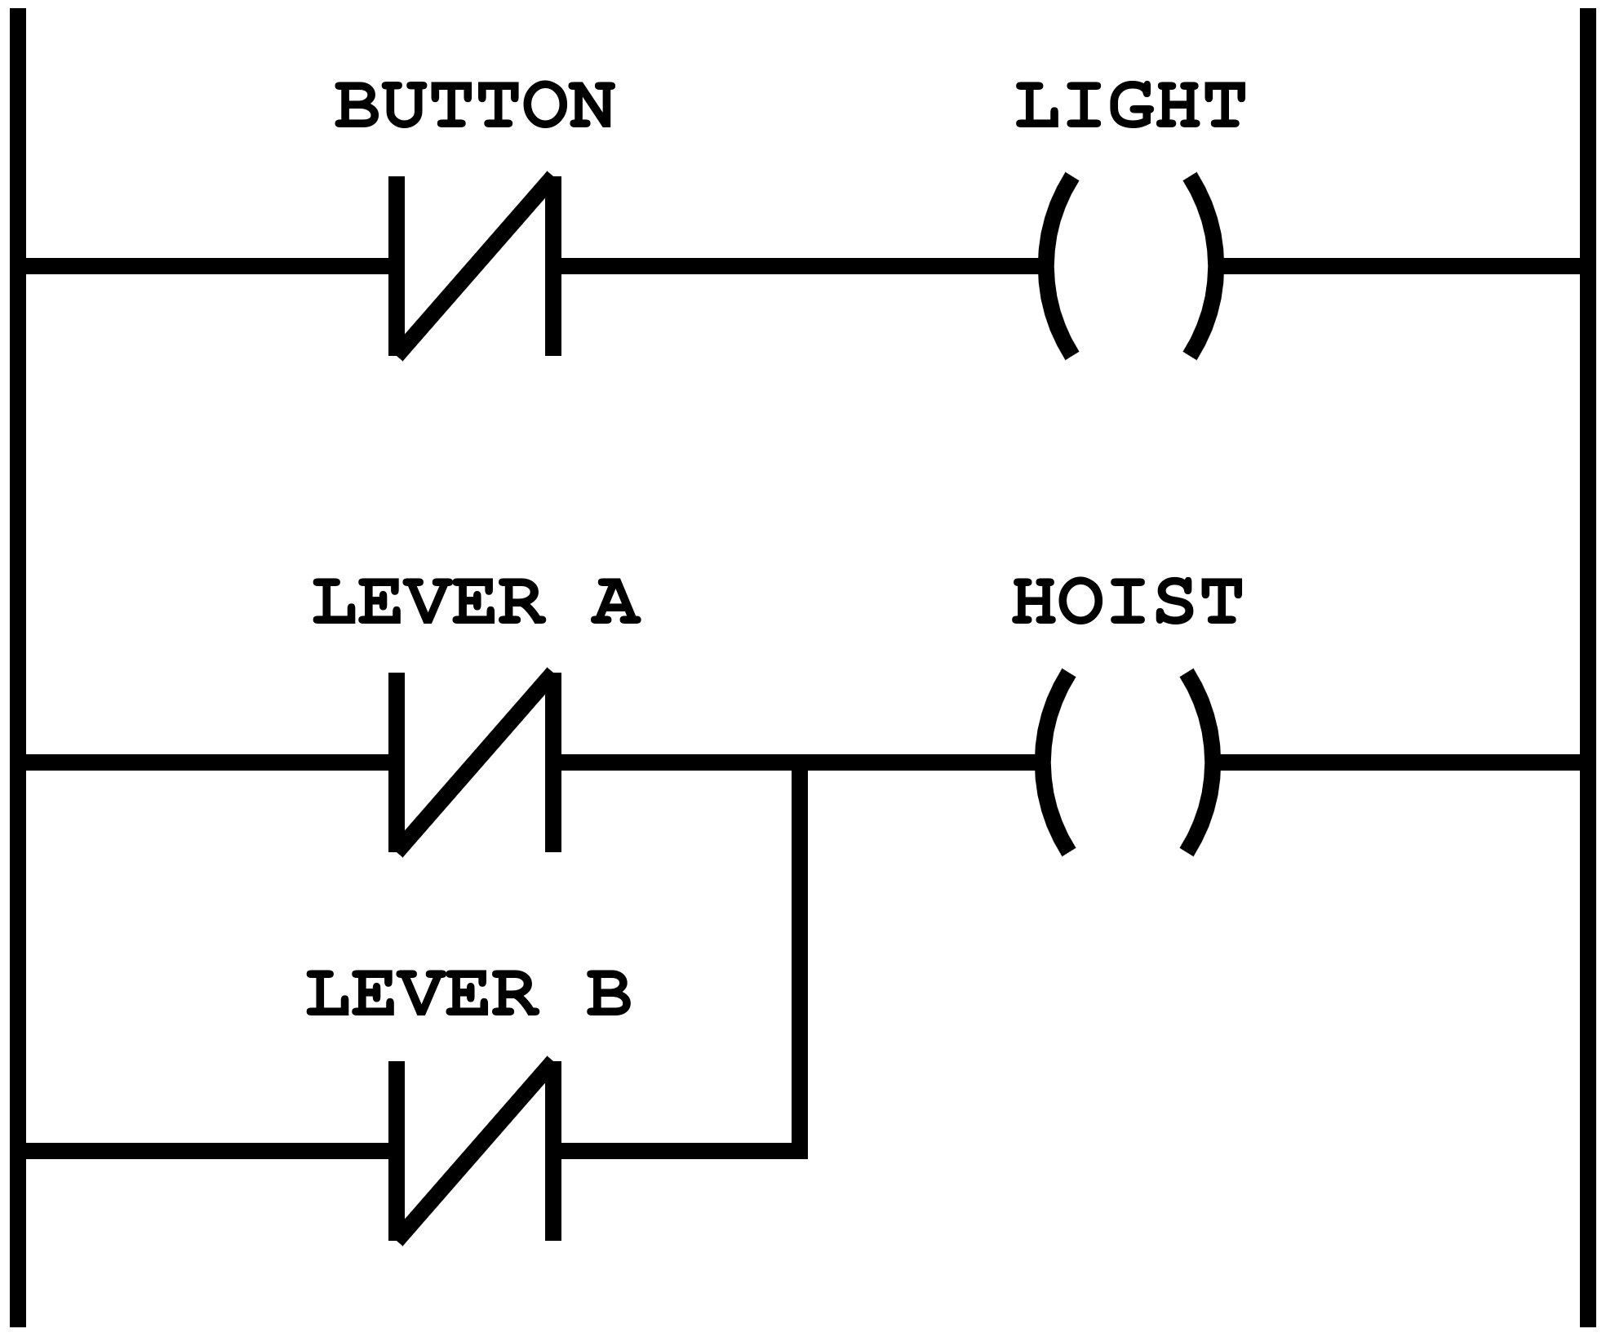
Understanding a diagram
A diagram in Ladder Logic is always read from left to right and from top to bottom

Slide 14
Rung A
Understanding a diagram
A diagram in Ladder Logic is always read from left to right and from top to bottom
Each rung on a diagram defines one operation in the control process
Rung B

Slide 15
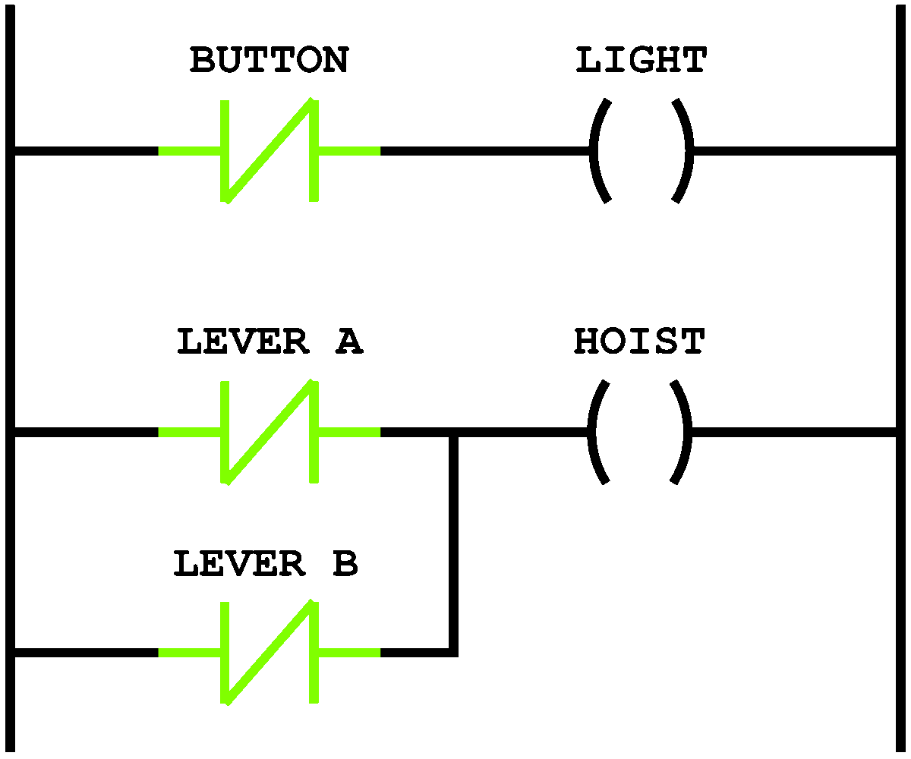
Rung A
Understanding a diagram
A diagram in Ladder Logic is always read from left to right and from top to bottom
Each rung on a diagram defines one operation in the control process
When a diagram is executed, the power flow cycles through the rungs following the same criteria as the reading
Rung B

Slide 16
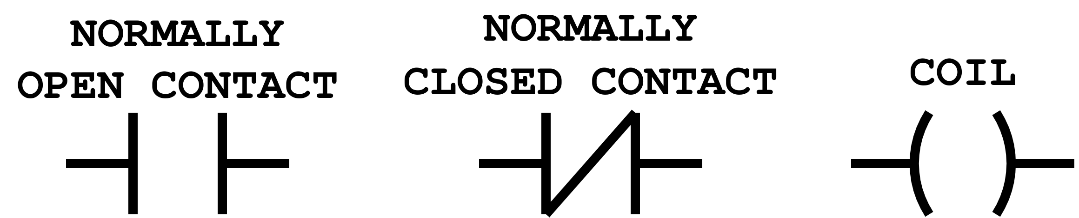
Symbols

Slide 17
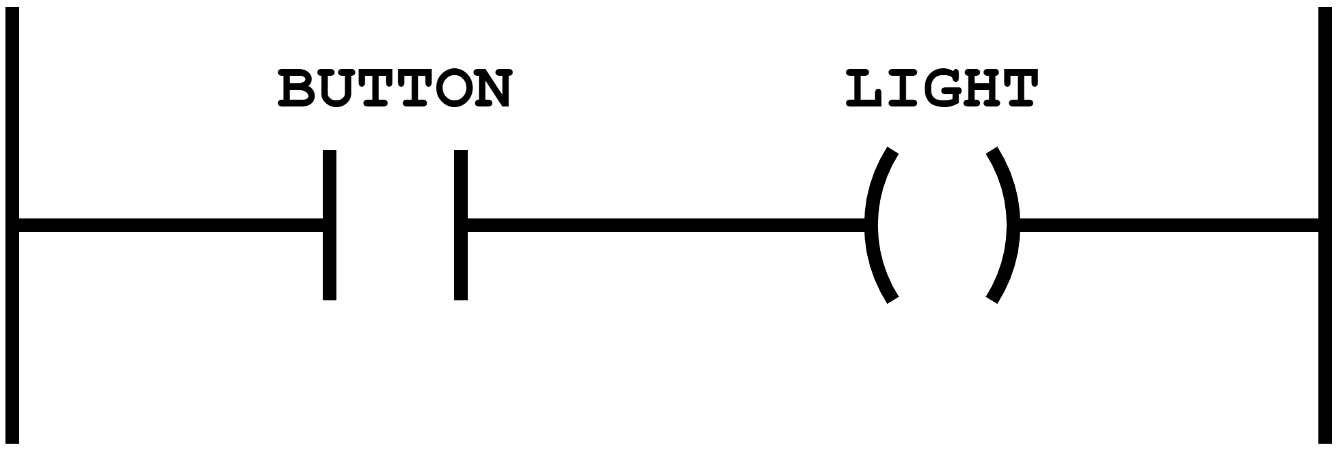
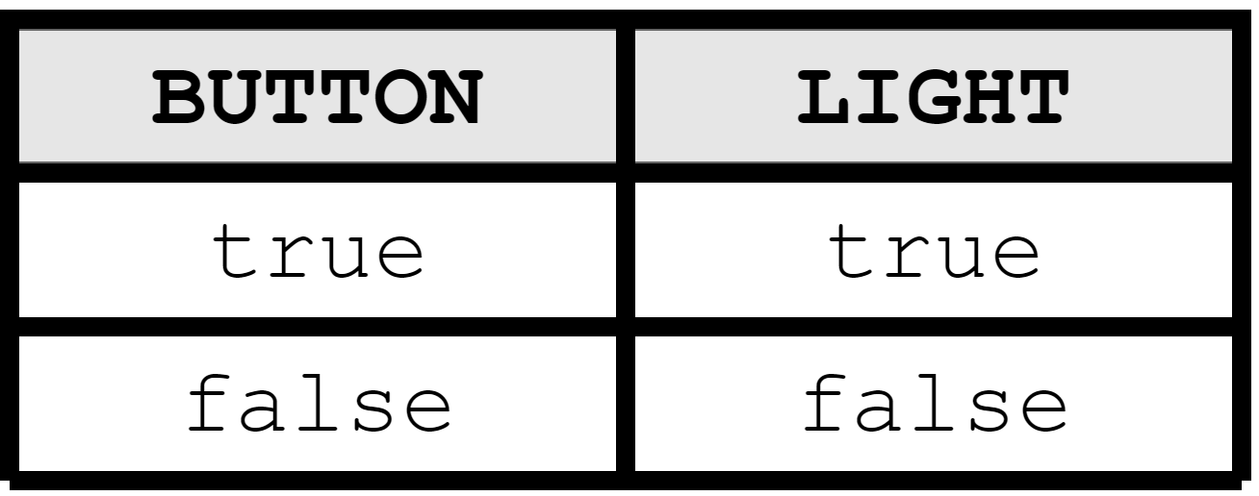
Simple Example

Slide 18
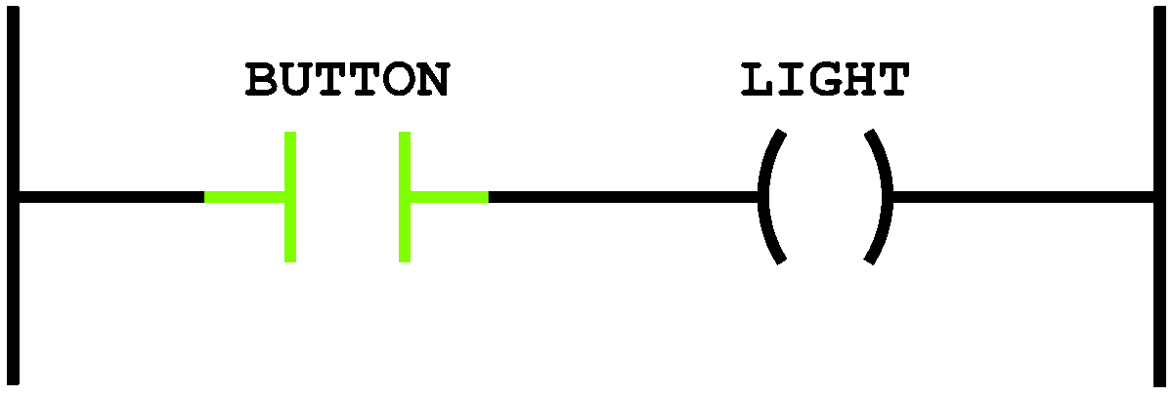

Simple Example

Slide 19
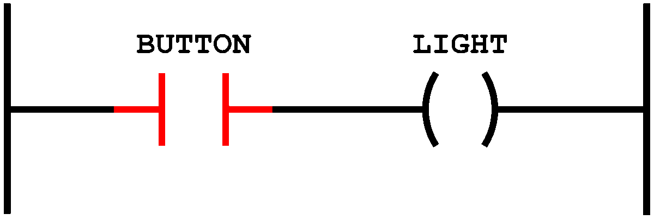


Simple Example

Slide 20
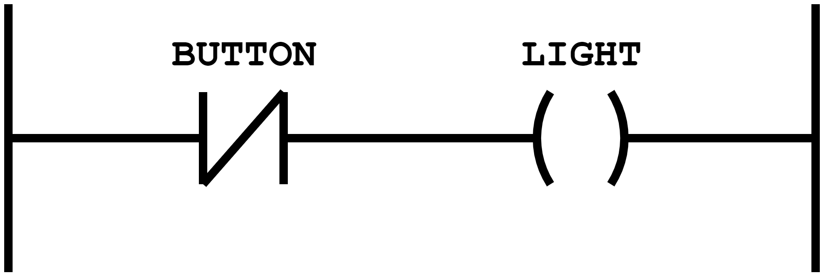
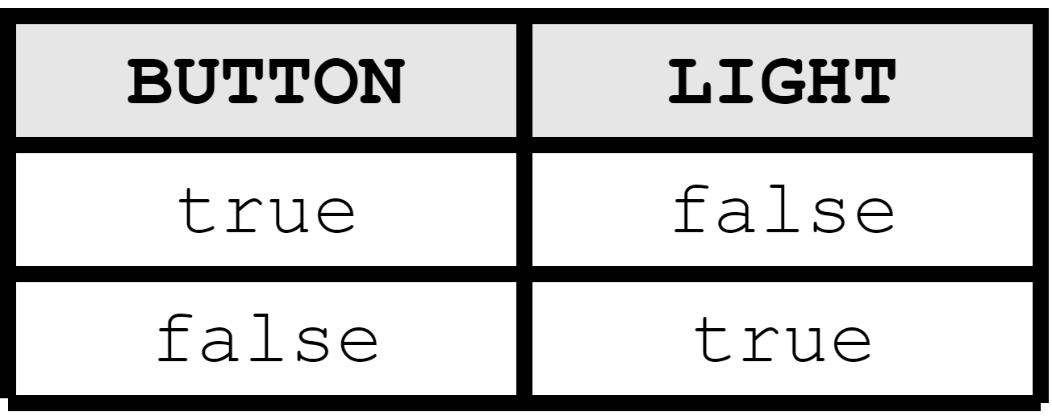
NOT Example

Slide 21
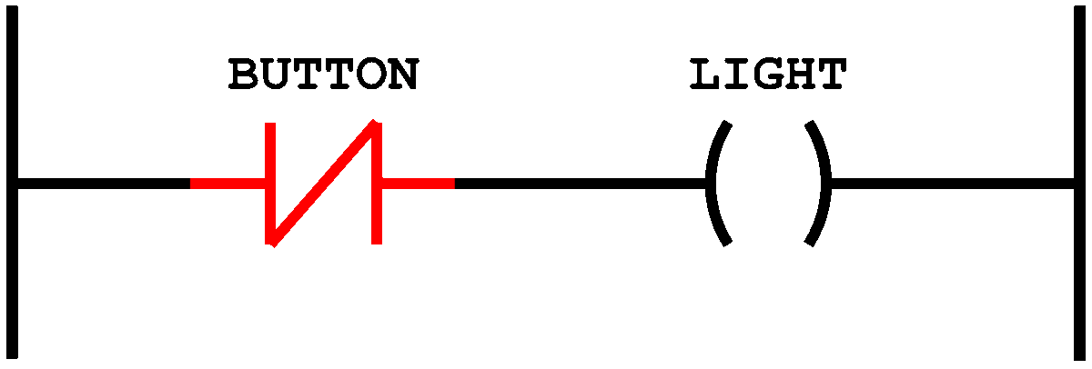
NOT Example

Slide 22
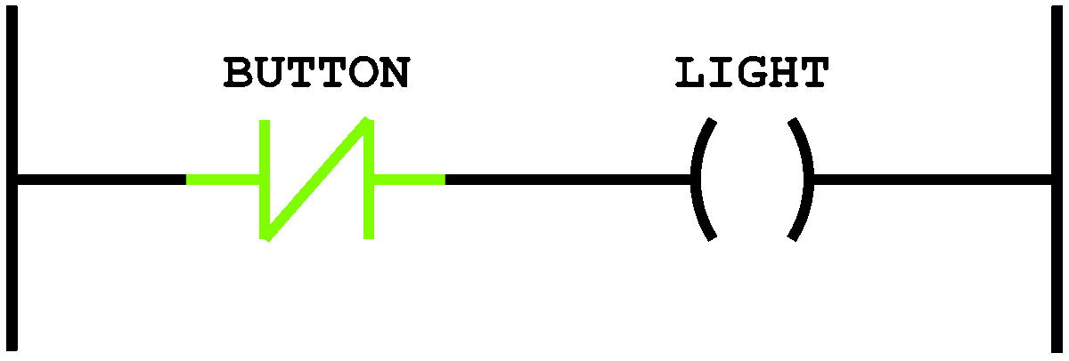
NOT Example

Slide 23
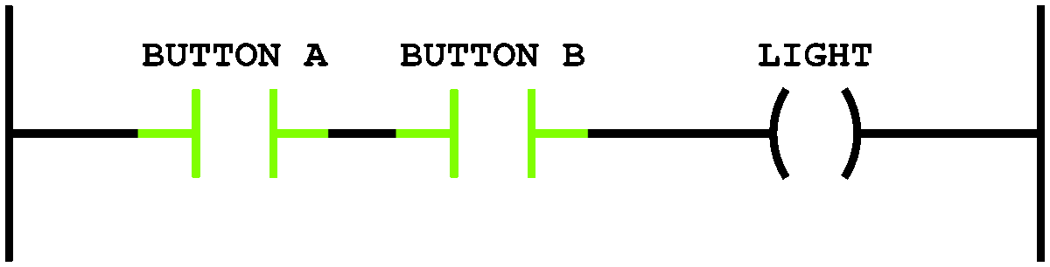
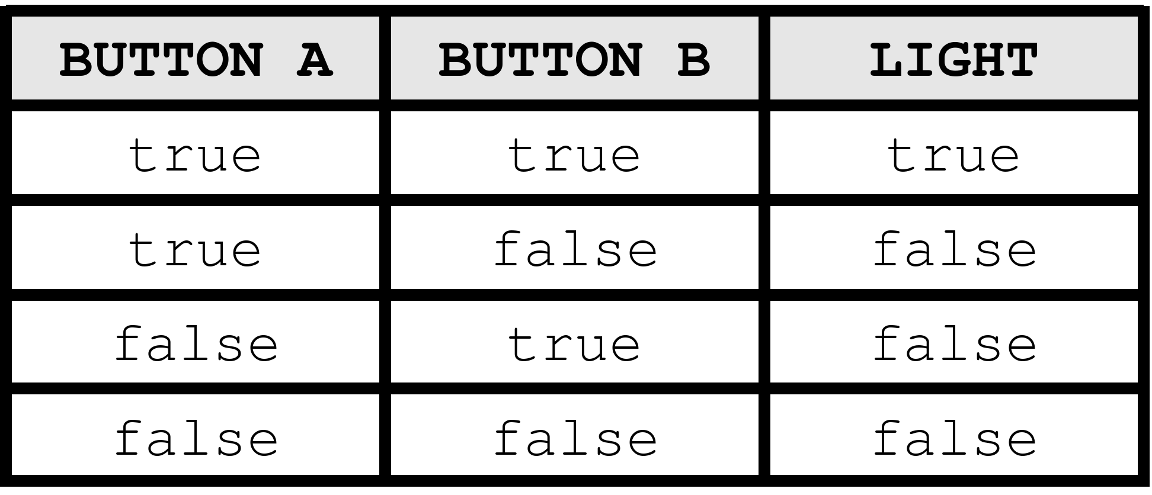
AND Example

Slide 24
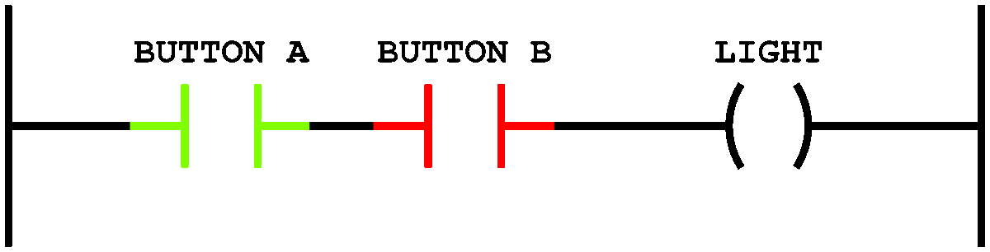
AND Example

Slide 25
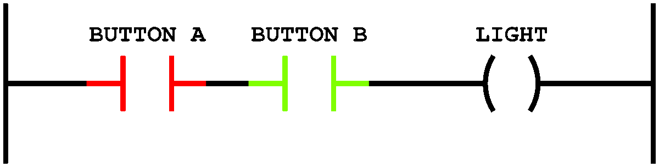
AND Example

Slide 26
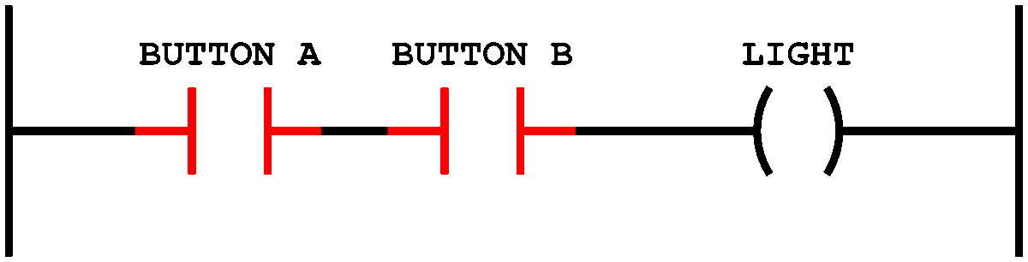
AND Example

Slide 27
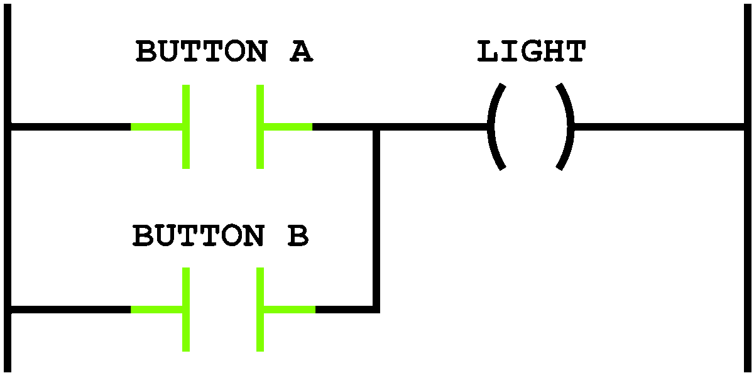
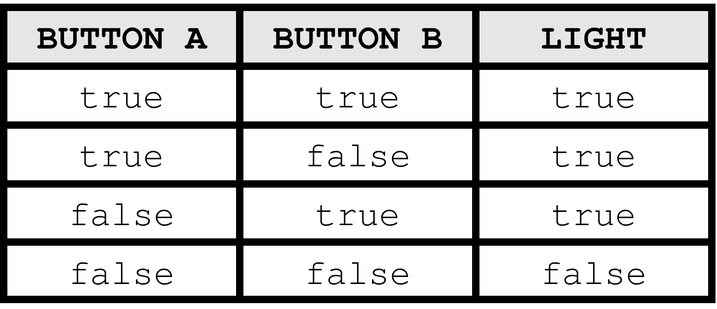
OR Example

Slide 28
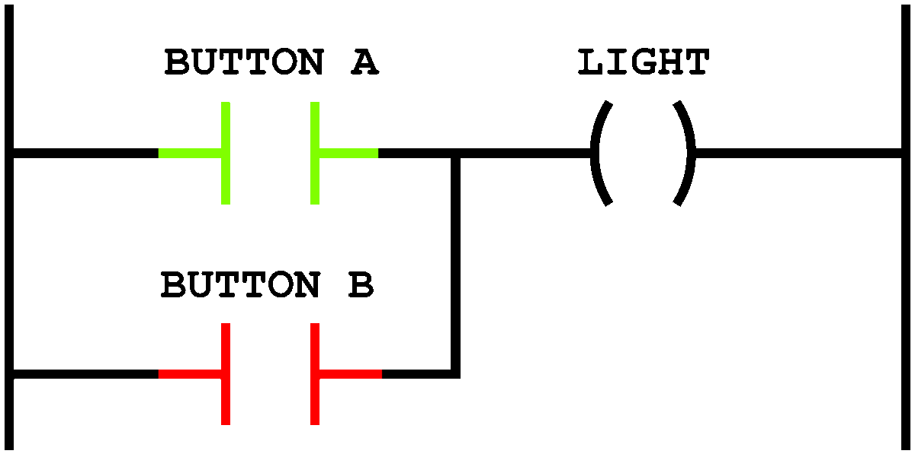
OR Example

Slide 29
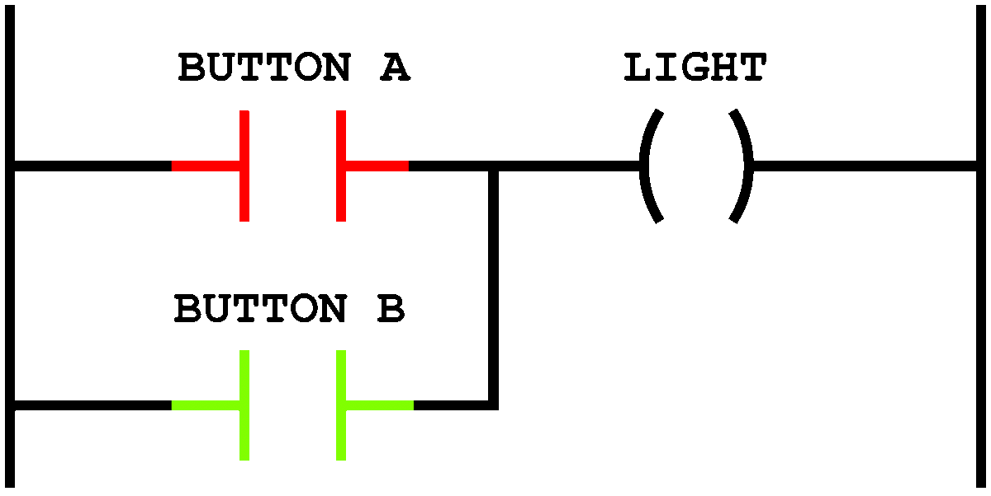
OR Example

Slide 30
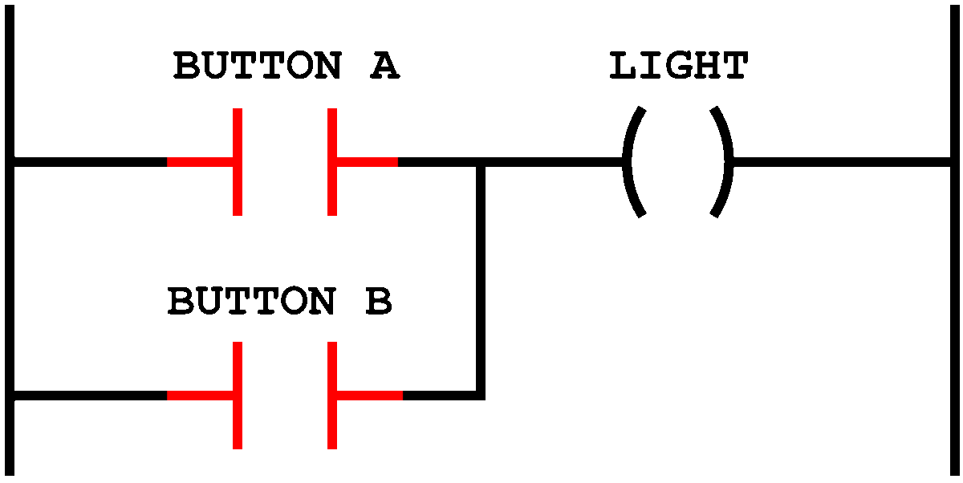
OR Example

